Slide 1
Cookbook for Practice 3.1
实践3.1攻略
Cong Li 李聪

Slide 2
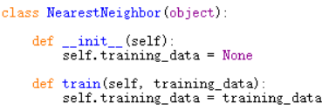
Nearest Neighbor 最近邻 (1)
Start a new file ‘nearestNeighbor.py’ w/ a new class. Follow the training part in rote learning.
创建一个包含新的类型的新文件“nearestNeighbor.py”。训练部分参照死记硬背的学习。

Slide 3

Nearest Neighbor 最近邻 (2)
Now we write the ‘classify’ function, starting w/ a local variable for minimal distance & another for the nearest data sample seen so far
现在我们写“classify”函数，为到目前为止遇到的最小距离和最邻近的数据各准备一个局部变量

Slide 4
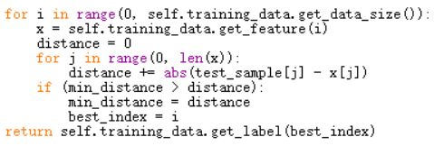
Nearest Neighbor 最近邻 (3)
Loop over all the training data samples, calculate the distance, & update the minimum distance & the nearest neighbor on demand. Return the class label of the nearest neighbor at the end.
遍历所有的训练数据，计算距离，并根据情况更新最小距离和最近邻。最后返回最近邻的类别。
Distance calculation 距离计算

Slide 5

Run It 运行之
In ‘tester.py’, print something for every 100 data samples classified 在“tester.py”中，每分类100个数据就打印一下
In ‘test.py’, import ‘nearestNeighbor’, follow rote learning to create an instance for performance evaluation
在“test.py”中，导入“nearestNeighbor”，参照死记硬背的学习，创建其中类型的实例，对其分类性能进行评估
Train on ‘usps’, test on ‘usps.t’ (& be very patient)
用“usps”进行训练，用“usps.t”进行评估（并表现出异常的耐心）

Slide 6
The End

